Slide 1


SmartHirePRO
SmartHirePRO
By Team Kodak CS691(CRN21669) February 2024

Slide 2
Table of Contents.
Problem statement
Project Description
Retrospectives
Schedule & sprint burndown chart
01
02
03
04

Slide 3
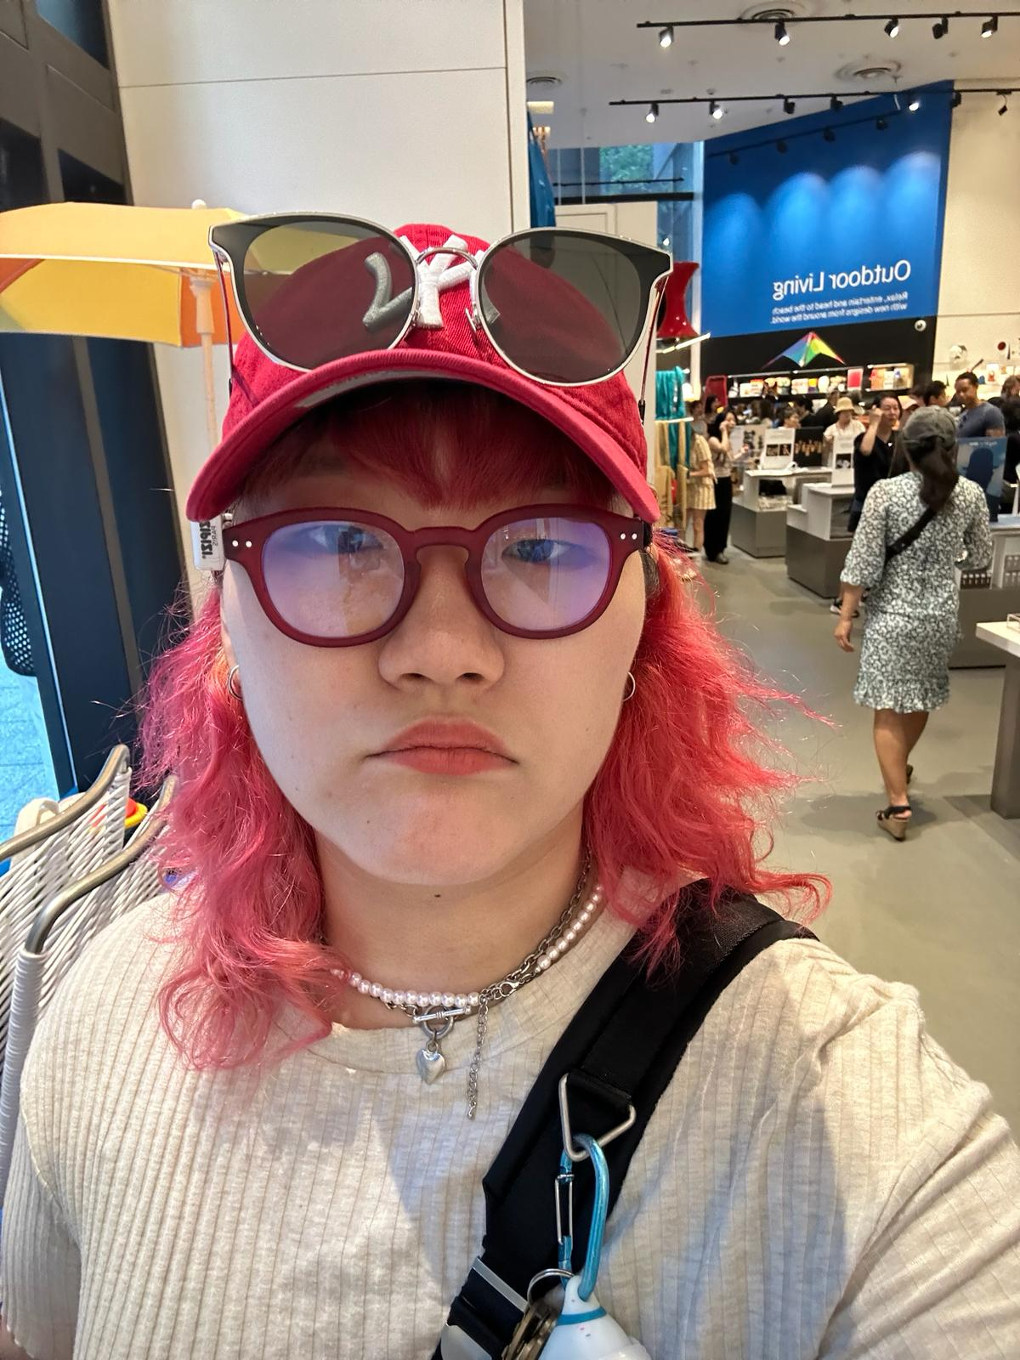



This is our team Kodak.
Seungah choi
Yadu Vamsi U.
Sreeja Karukonda
Aashlehsa Shirole
Full stack Developer
Full Stack Developer
QA Analyst and DBA
Front-End Developer

Slide 4
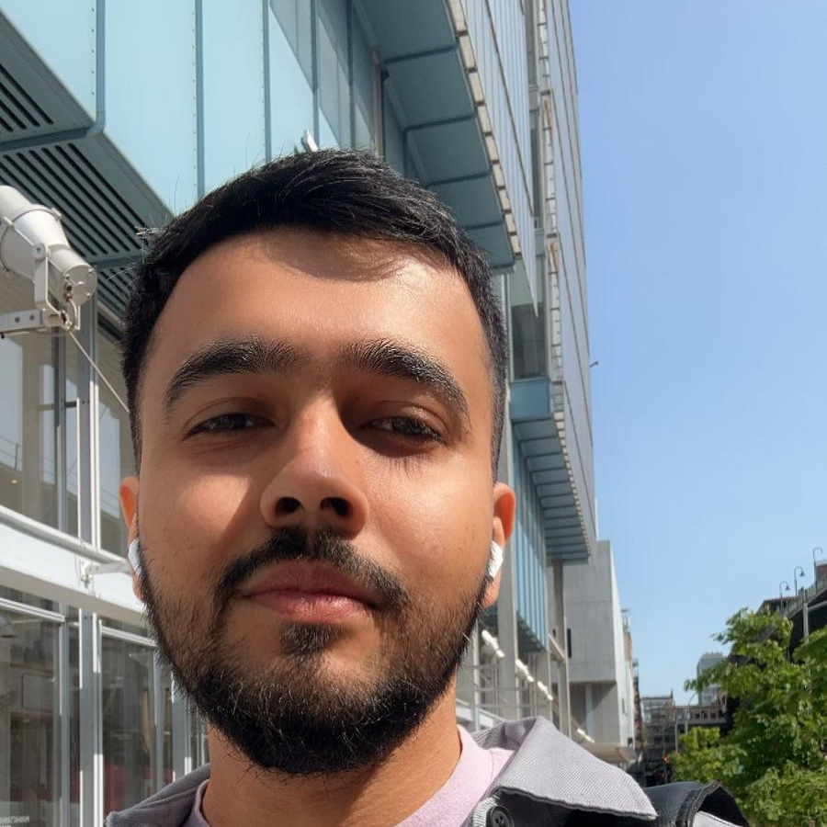
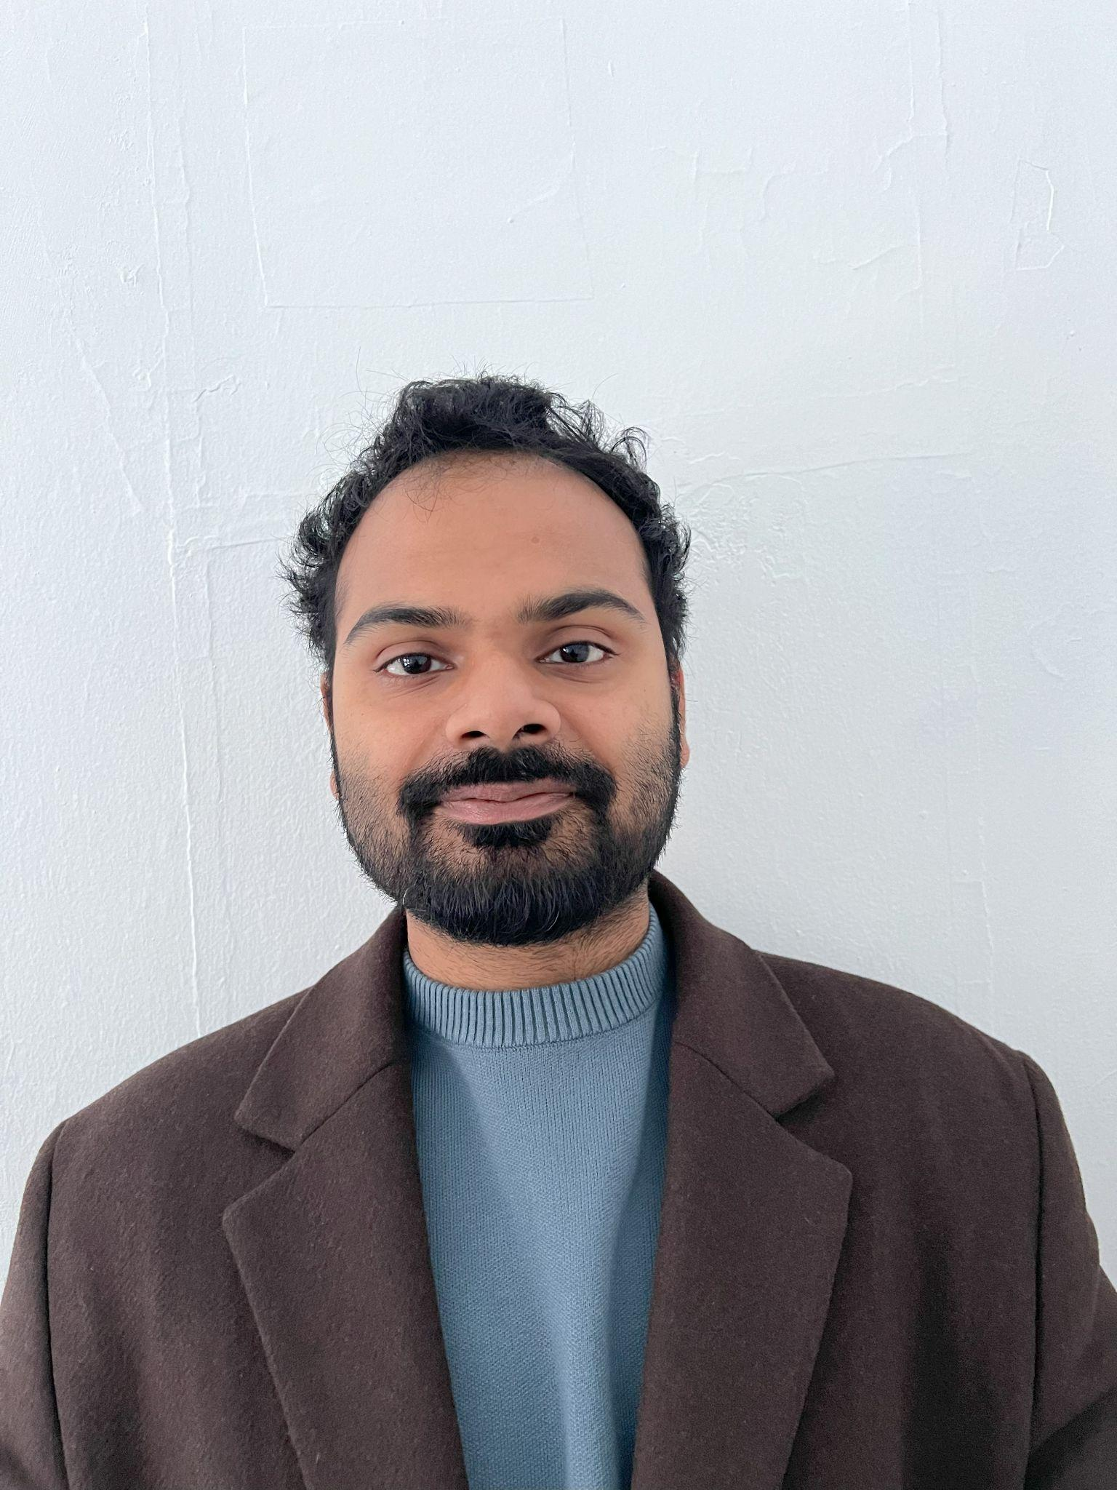


This is our team Kodak.
Hrushikesh Joshi
Sujay Sail
Ashish Sudam
Yash Jani
Backend and Data Engineer
DevOps Engineer
Data Engineer
Front-End Developer (React)
Site Reliability Engineer.

Slide 5
Problem statement
01
Resume Parsing and Summarization:
An AI agent will process user resumes, extracting key skills and experiences. This summarized information will form the basis for job searches.
Reed.co.uk Job Search via API:
Utilizing the reed.co.uk Jobseeker API, the system will search for relevant job postings that match the user's profile.
Future Enhancements: We envision expanding the platform by:
Compatibility Scoring: Implementing a keyword-based similarity check to rank retrieved relevant jobs,.
Mobile App Development: Extending the platform to mobile devices for wider accessibility and user convenience.

Slide 6
Project Description
02
What:
Our project aims to create a job recommendation system that provides the user with a targeted list of jobs based on the skills and experience in the resume of the user
We quantify the compatibility of the job and user by a scoring system based on the skills required for the job and the skills of the user.
How:
We plan to use a text extractor that gathers all skills present in the resume of a user.
We'll use the extracted skills from the resume to search for targeted and relevant jobs for the user.
We'll generate score that weighs the skill required for the job and the skills possessed by the user to indicate the relevance of the job
Why:
The project highlights the importance of which jobs the user should consider to apply rather than what they desire to apply for.
The project proposes a more realistic approach to apply or search for jobs in hope to reduce unsuccessful job applications.
Users can monitor their skill gaps to enhance their future job search strategies.

Slide 7
Personas

Slide 8

Maria, the Ambitious Software Engineer
"I'm tired of spending hours searching for jobs that aren't right for me. This platform seems like a great way to find relevant opportunities that match my skills and career goals."
Demographics:
Age: 28
Location: London, UK
Education: Master's Degree in Computer Science
Experience: 3 years as a Software Developer
Skills and Qualifications:
Proficient in Python, Java, and JavaScript
Experience with web development and machine learning
Strong analytical and problem-solving skills
Excellent communication and teamwork abilities
Goals and Needs:
Looking for a challenging and rewarding software engineering role that utilizes her skills and experience.
Wants to find a job that aligns with her interests and career aspirations.
Struggles to stay up-to-date on the latest job openings and find relevant opportunities that match her profile.

Slide 9

Audrey, Film editor
Demographics:
Age: 24
Location: Amsterdam, Netherlands
Education: Bachelor of Arts in Film and Screen studies
Experience: none
Skills and Qualifications:
Proficient in adobe suites, and some Avid video editing
Experience with filming with 16mm camera
Strong communication and problem-solving skills
Great teamwork abilities
Goals and Needs:
Searching for a full time opportunity that uses her degree
To have a personal assistant-like tool that will suggests as many jobs as there are in the market for her to aggressively apply right after college

Slide 10

Daiman, Technical Support Assistant
Demographics:
Age: 27
Location: Birmingham, UK
Education: Bachelor's Degree in Information Technology
Experience: 2 yrs
Skills and Qualifications:
Experience in Technical Support
Certified AWS CPP
100 hrs plus Data Science courses completed on Datacamp
Competed in multiple hackathons based on machine learning on HackerEarth
Goals and Needs:
Determine to change career paths from technical support to a career in Data science
After countless unfruitful applications, looking job recommendations that encapsulates all his recently acquired skills

Slide 11
Minimal viable product
Core Functionality:
Resume Parsing:
Basic skill and experience extraction using pre-trained models or simple keyword matching.
No complex semantic analysis or advanced natural language processing (NLP) at this stage
Job Search:
Connect to the reed.co.uk Jobseeker API using basic search capabilities based on extracted keywords from the resume.
Initially, return a simple list of matching jobs without ranking or compatibility scoring.
User Interface:
Simple web interface:
Allow users to upload their resume and receive a list of relevant job postings from reed.co.uk.
No fancy features or complex navigation at this stage.
Metrics and Feedback:
Track basic usage metrics like number of users, resumes uploaded, and job searches conducted.
Gather user feedback through surveys or interviews to understand their experience and pain points.
Key Learnings:
Validate the core concept of using AI to recommend jobs based on resumes.
Identify the most valuable features and functionalities to prioritize in future development.
Gain insights into user behavior and preferences to refine the product roadmap.

Slide 12
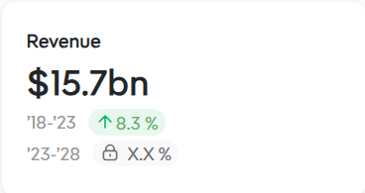
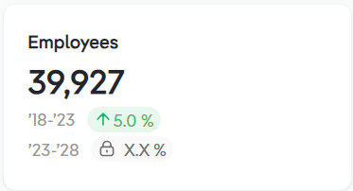
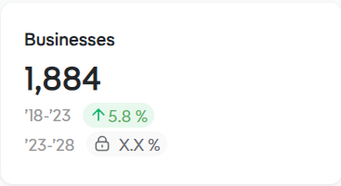
Market Analysis
The Online Recruitment Sites industry has boomed since the 2000s as job searches have moved online and the internet has become an indispensable part of daily life. The internet has become the primary medium for communicating and accessing information, the main driving force behind this industry's rise. Job seekers and employers have increasingly turned to online recruitment sites to look for new openings and find new talent pools. Revenue generated from online recruitment sites is expected to grow at a CAGR of 8.3% to $15.7 billion over the five years to 2023. While growth has been fueled by an extremely tight labor market following pandemic disruptions, revenue is forecast to contract 4.6% in 2023.*
*https://www.ibisworld.com/united-states/market-research-reports/online-recruitment-sites-industry/#IndustryStatisticsAndTrends

Slide 13
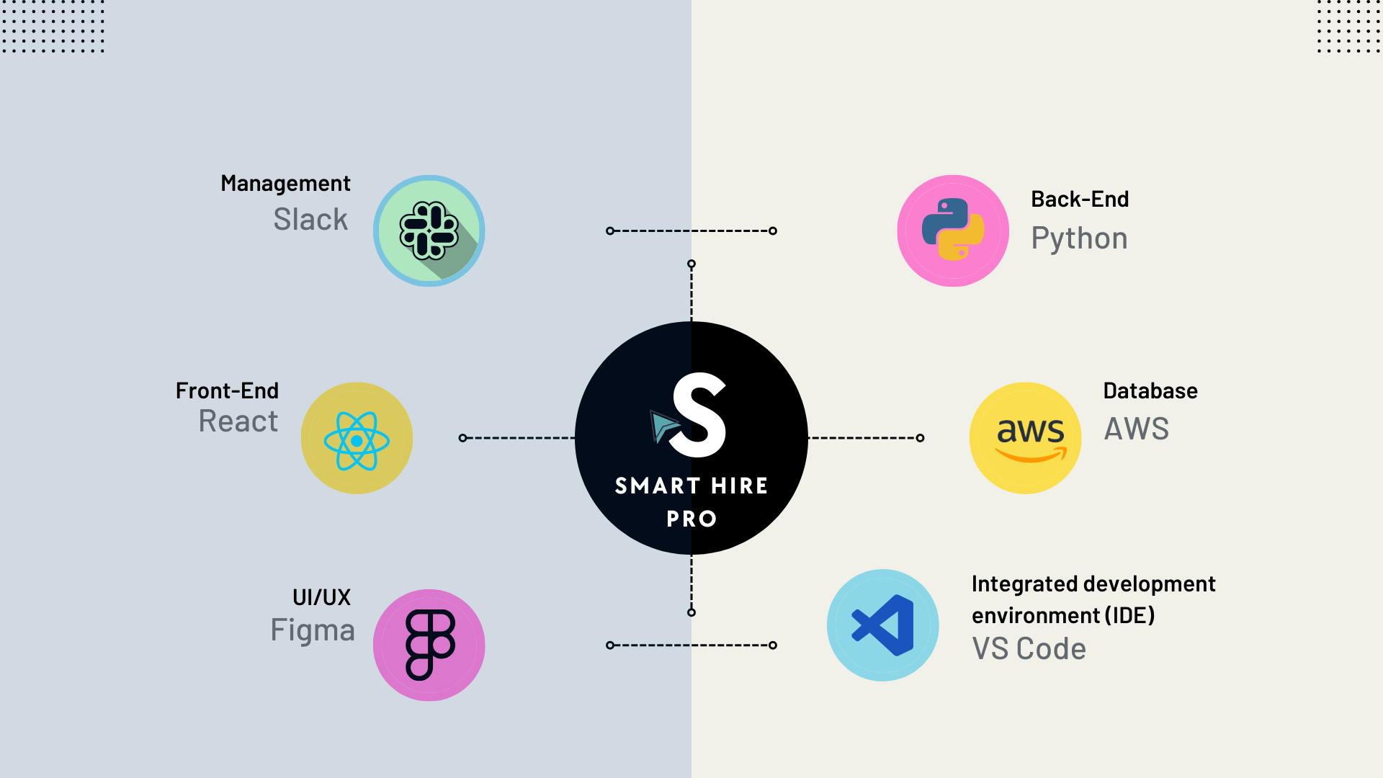
Languages and Tools
02

Slide 14
Retrospectives
03
What went well?
What could be improved?
What are our commitmentment
Switching from whatsapp to slack where it has multiple channels for different teams
Clarity on the project
Every team member is voluntarily contributing to the same goal
- Improvements on feedback tailoring to specific team members
- Better compartmentalization of the work to avoid overlap and increase the work productivity
- Beginning of every month’s weekly meeting we will evaluate our personal progress

Slide 15

Retrospectives (cont.)
What are our commitments
-Maintain the positive communication we already have and always refer back to the team agreement otherwise
- After every sprint the team will identify areas for improvements and revisit or revise the project if necessary

Slide 16
Project Timeline
04
Deliverable 1
Deliverable 2
Deliverable 3
Deliverable 4
Feb 14, 2024
Mar 13, 2024
April 10, 2024.
May 8, 2024

Slide 17
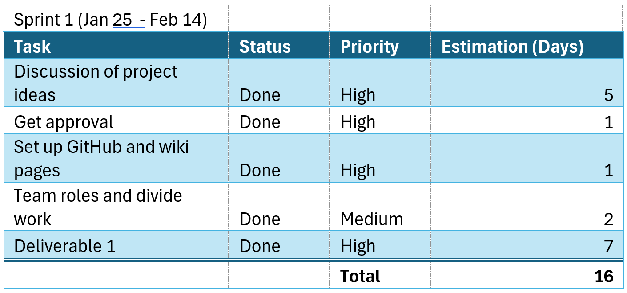
Sprint 1 Burndown Charts and Completed Tasks
.

Slide 18
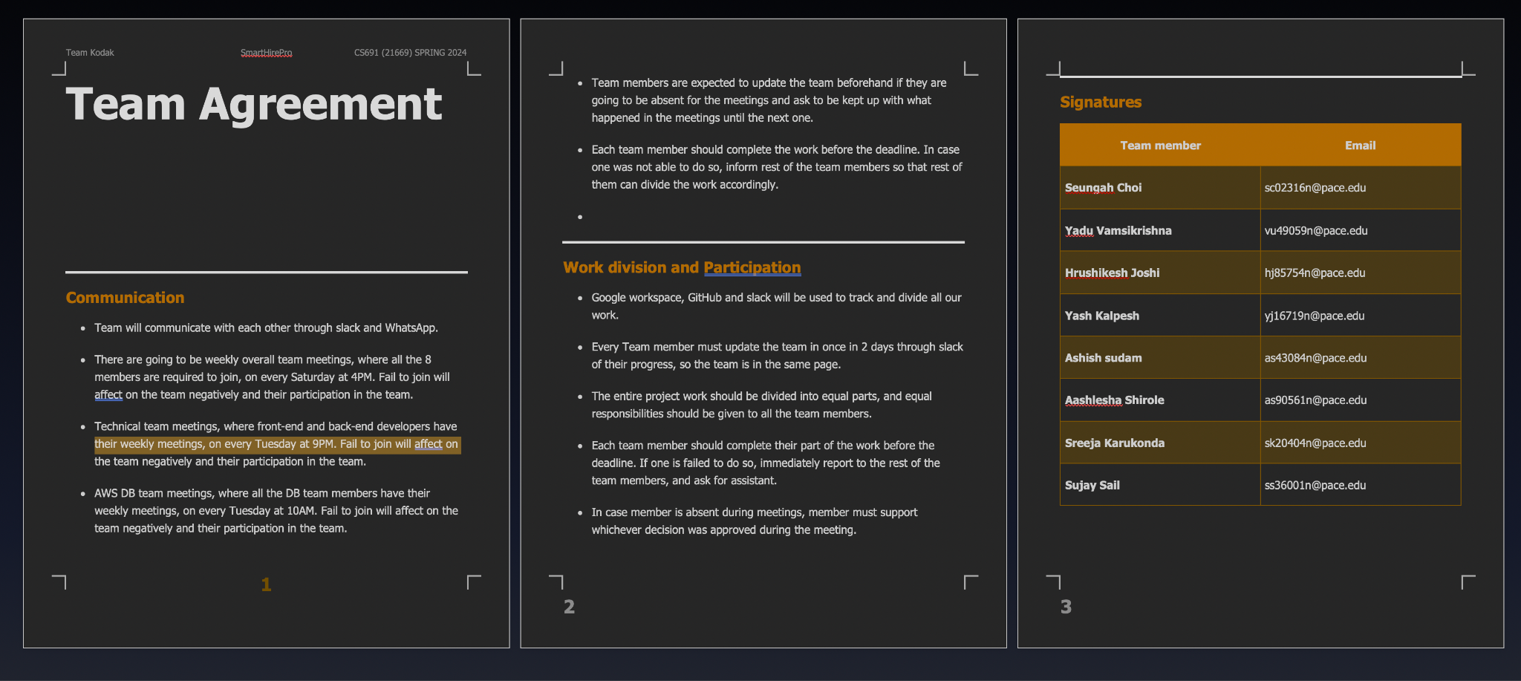
Teamwork agreement

Slide 19
Thank you!
Do you have any questions?

